Slide 1
Problem Solving and Search

Slide 2
Missionaries and cannibals
Three missionaries and three cannibals are on the left bank of a river.
There is one canoe which can hold one or two people.
Find a way to get everyone to the right bank, without ever leaving a group of missionaries in one place outnumbered by cannibals in that place.

Slide 3
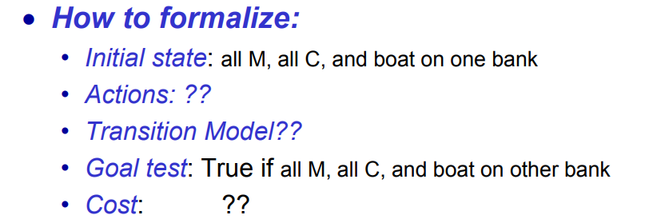

Slide 4
Missionaries and cannibals
States: three numbers (i,j,k) representing the number of missionaries, cannibals, and canoes on the left bank of the river.
Initial state: (3, 3, 1)
Operators: take one missionary, one cannibal, two missionaries, two cannibals, one missionary and one cannibal across the river in a given direction (I.e. ten operators).
Goal Test: reached state (0, 0, 0)
Path Cost: Number of crossings.

Slide 5

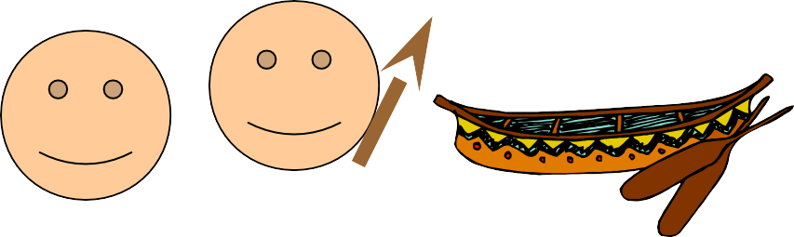
Missionaries and Cannibals
(3,3,1)

Slide 6
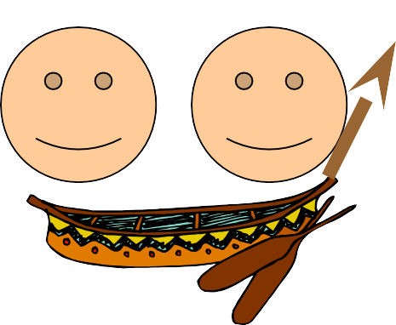
Missionaries and Cannibals
A missionary and cannibal cross

Slide 7

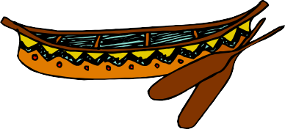
Missionaries and Cannibals
(2,2,0)

Slide 8
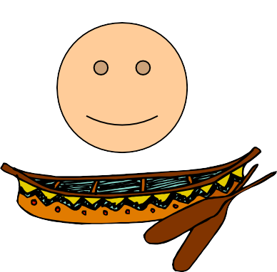
Missionaries and Cannibals
One missionary returns

Slide 9

Missionaries and Cannibals
(3,2,1)

Slide 10

Missionaries and Cannibals
Two cannibals cross

Slide 11


Missionaries and Cannibals
(3,0,0)

Slide 12

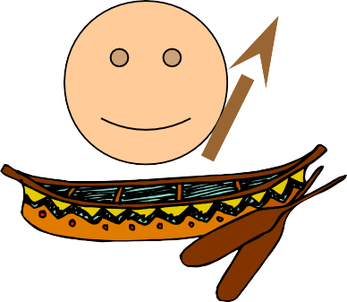
Missionaries and Cannibals
A cannibal returns

Slide 13


Missionaries and Cannibals
(3,1,1)

Slide 14
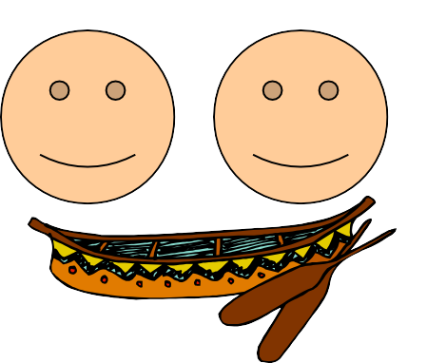
Missionaries and Cannibals
Two missionaries cross

Slide 15

Missionaries and Cannibals
(1,1,0)

Slide 16

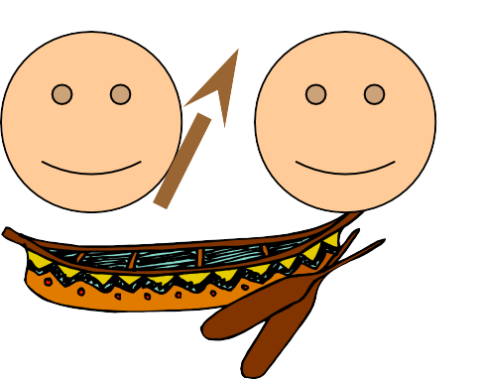
Missionaries and Cannibals
A missionary and cannibal return

Slide 17


Missionaries and Cannibals
(2,2,1)

Slide 18

Missionaries and Cannibals
Two Missionaries cross

Slide 19

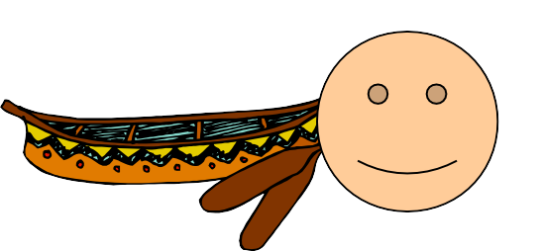
Missionaries and Cannibals
(0,2,0)

Slide 20
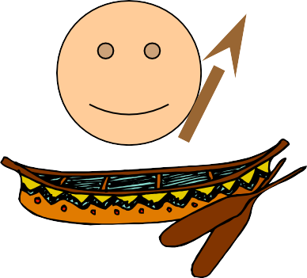
Missionaries and Cannibals
A cannibal returns

Slide 21
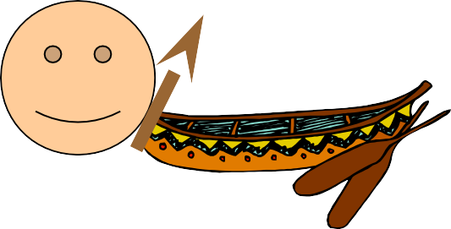
Missionaries and Cannibals
(0,3,1)

Slide 22
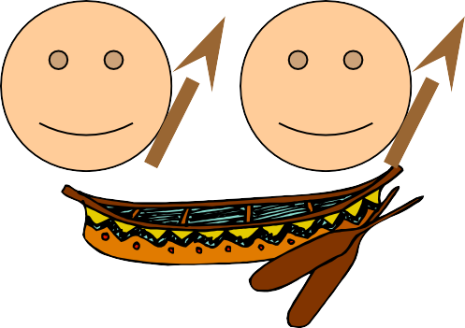
Missionaries and Cannibals
Two cannibals cross

Slide 23

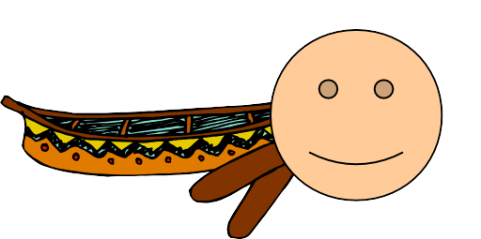
Missionaries and Cannibals
(0,1,0)

Slide 24

Missionaries and Cannibals
A cannibal returns

Slide 25


Missionaries and Cannibals
(0,2,1)

Slide 26

Missionaries and Cannibals
The last two cannibals cross

Slide 27
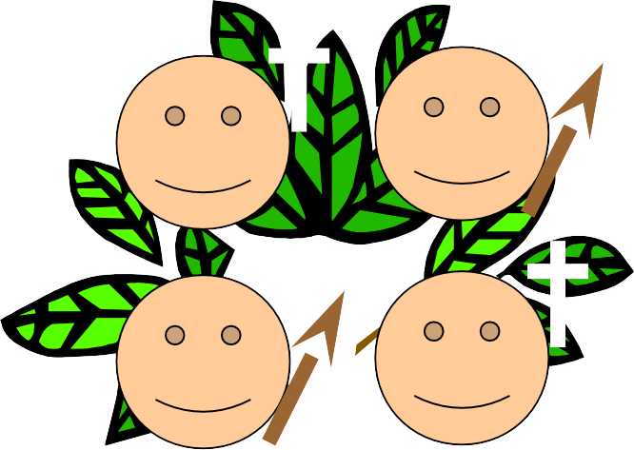
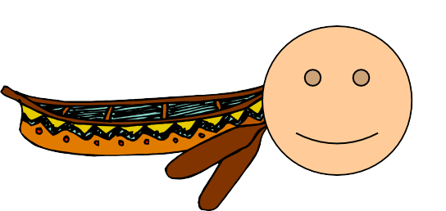
Missionaries and Cannibals
(0,0,0)

Slide 28
